Slide 1
Revision History
Version | Unit | Unit | Slide No | Change Type | Description of Change | Remark
V3.0 | Unit 1. NumPy Array Data Structure for Optimal Co mputational Performance | 1.2, 1.3, 14 | 114, 115, 139, 150, | Revised | Corrected the parts of the practi ce problems that were not conne cted to the textbook.
 | Unit 2 Optimal Data Explo ration Through Pandas | 2.1, 2.2, 2.3, 2.4 | 283, 284, 316, 322, 340 | Revised | Corrected the parts of the practice problems that were not connected to the textbook.
 | Unit4 Data Visualization f or Various Data Scales | 4.4, 4.5 | 471, 472, 520 | Revised | Corrected the parts of the practice problems that were not connected to the textbook.
 | Unit 2 Optimal Data Exploration Through Pandas | 2.2, 2.3 | 283, 284, 316, 322 | Revised | Modify file names included in pr actice description notes
 | Unit 3 Pandas Data Preprocessing for Optimal Model Execution | 3.3 | 356, 364, 360, 361, 363 | Revised | Modify variable names and num ber of data included in notes(356 , 360, 361). Move the practice page(ex_0109 ) to another location and Edit lab description(364). fix typo(363)
 | Unit 3 Pandas Data Preprocessing for Optimal Model Execution | 3.5 | 412 | Revised | Added missing exercises(ex_011 0). New exercises using TV_Sale s data.
 |  |  | almost all | Revised | Screenshots of the modified cod e are reflected in the textbook.
 | Unit 2 Optimal Data Exploration Through Pandas | 2.4. DataFrame Sortin g and Multi-Index | 45, 339 | Revised | fixed typo(45), Change lab locati on(339)

Slide 2
Revision History
Version | Unit | Unit | Slide No | Change Type | Description of Change | Remark
 | Unit 1. NumPy Array Data Structure for Optimal Co mputational Performance | 1.2. NumPy Array Basi cs | 47 | Revised | Edited slide description
 |  | 1.3. NumPy Array Oper ations | 85 | Revised | Change code screenshot
 | Unit 2 Optimal Data Exploration Through Pandas | 2.2, 2.3, 2.4, 2.5 | 247-257, 297, 298, 319, 336-339 | Revised | Change code screenshot
 | Unit 3 Pandas Data Preprocessing for Optimal Model Execution | 3.1. Data Preprocessin g | 342, 343 | Revised | Edited slide description

Slide 3




Slide 4





Slide 5


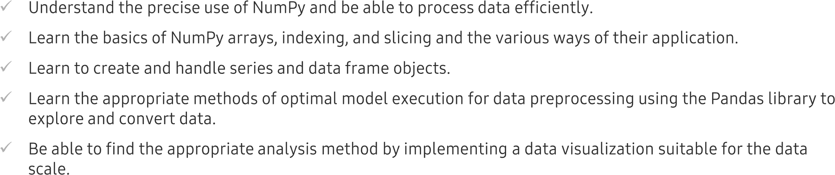


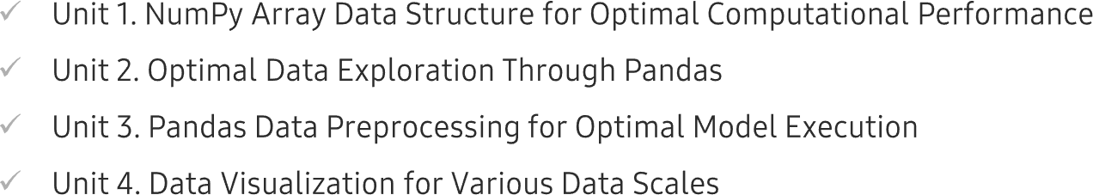
Chapter Description

Slide 6



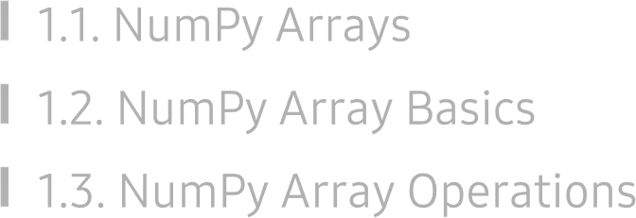
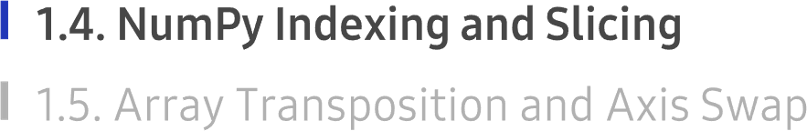

Slide 7




1.4. NumPy Indexing and Slicing
UNIT 01

Slide 8

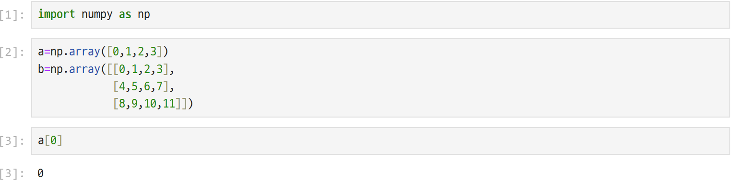
1.4. NumPy Indexing and Slicing
UNIT 01

Slide 9
Program
import numpy as np
# Create a 1D array
a = np.array([0, 1, 2, 3])
# Create a 2D array
b = np.array([[0, 1, 2, 3],
[4, 5, 6, 7],
[8, 9, 10, 11]])
# Access the first element of array 'a'
print(a[0])
Output
0

Slide 10
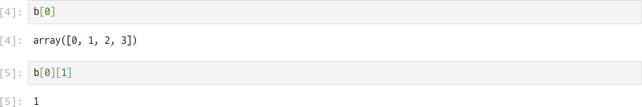

1.4. NumPy Indexing and Slicing
UNIT 01
# Access the first row
print(b[0])
# Access the second element of the first row
print(b[0][1])
Output
[0 1 2 3]
1
Line 5
Can access one specific multi-dimensional value.

Slide 11
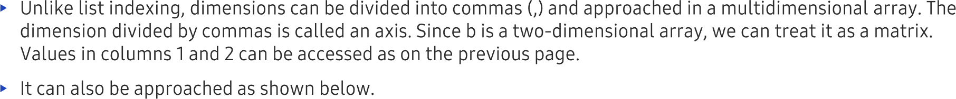
1.4. NumPy Indexing and Slicing
UNIT 01
# Access an element using comma indexing
print(b[0,1])
Output
1

Slide 12
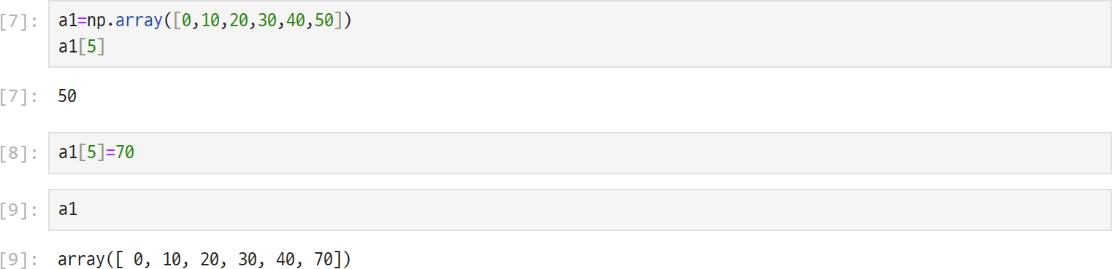
1.4. NumPy Indexing and Slicing
UNIT 01

Slide 13
# Create a 1D array
a1 = np.array([0, 10, 20, 30, 40, 50])
# Display the value at index 5
print(a1[5])
# Change the value at index 5
a1[5] = 70
# Display the updated array
print(a1)
Output
50
[ 0 10 20 30 40 70]

Slide 14
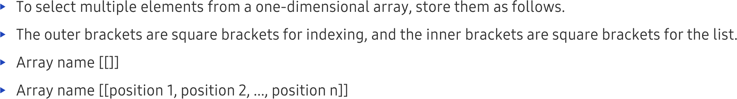

1.4. NumPy Indexing and Slicing
UNIT 01
Line 10
Elements 10, 30, and 40 located at positions 1, 3, and 4 were taken from the one-dimensional array a1.
Explains Fancy Indexing (also called Advanced Indexing) in NumPy.
Normally, we access one element using a single index.
Now, we can access multiple elements at once by giving a list of indices.

Slide 15
# Select multiple elements
print(a1[[1, 3, 4]])
Output
[10 30 40]

Slide 16
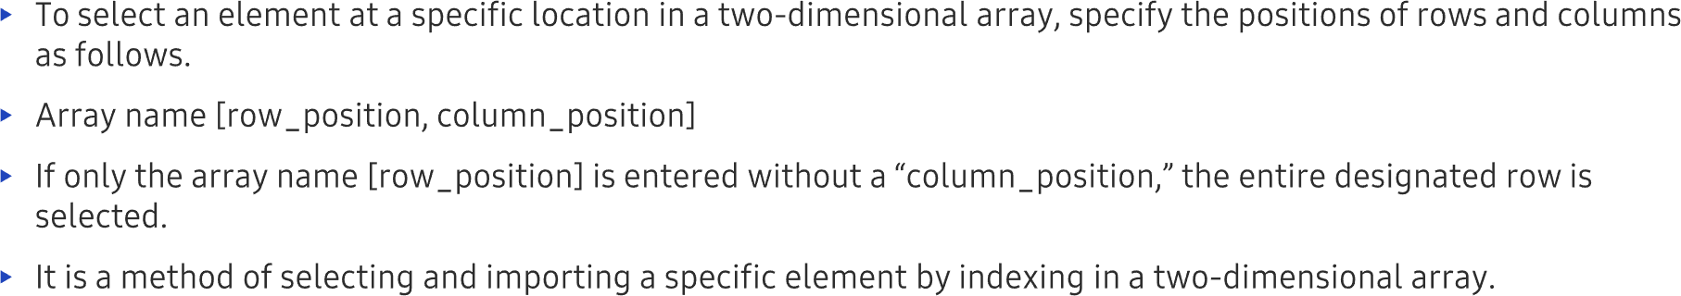
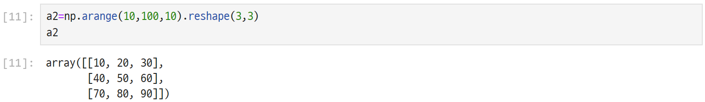
1.4. NumPy Indexing and Slicing
UNIT 01

Slide 17
Program
import numpy as np
# Create a 2D array
a2 = np.arange(10, 100, 10).reshape(3, 3)
# Display the array
print(a2)
Output
[[10 20 30]
[40 50 60]
[70 80 90]]

Slide 18
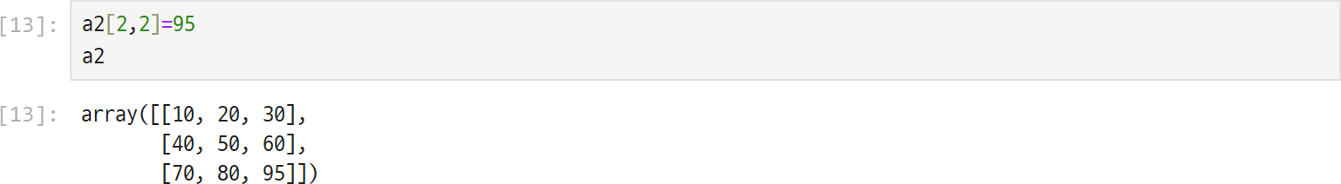
1.4. NumPy Indexing and Slicing
UNIT 01

Slide 19
import numpy as np
# Create a 3 × 3 array
a2 = np.arange(10, 100, 10).reshape(3, 3)
print(a2)
Output
[[10 20 30]
[40 50 60]
[70 80 90]]

Slide 20
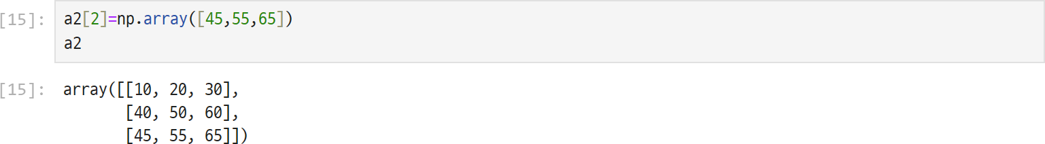
1.4. NumPy Indexing and Slicing
UNIT 01
print(a2[1])
Output
[40 50 60]
a2[2] = np.array([45, 55, 65])
This means
Replace Row 2 with the new values 45, 55, and 65.

Slide 21
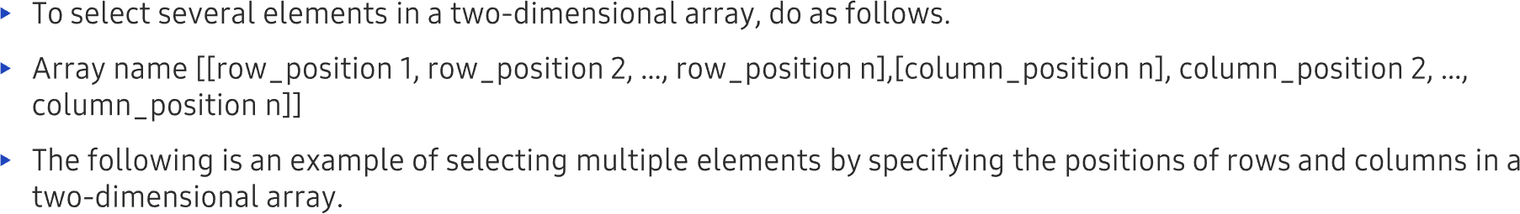
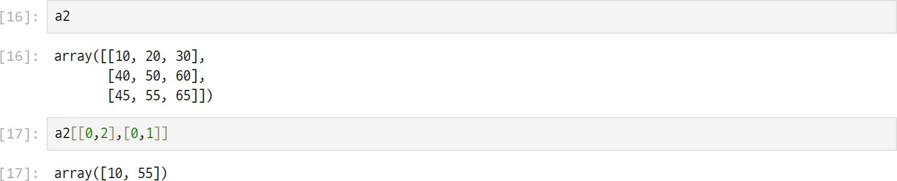
1.4. NumPy Indexing and Slicing
UNIT 01
Line 17
If you select the row first from [10, 20, 30] and the column from [45, 55, 65], then 10 and 55 are returned.

Slide 22
Row \ Column | 0 | 1 | 2
0 | 10 | 20 | 30
1 | 40 | 50 | 60
2 | 45 | 55 | 65
Continue from the Previous Program
import numpy as np
# Create a 3 × 3 array
a2 = np.array([[10, 20, 30],
[40, 50, 60],
[45, 55, 65]])
print(a2)
Output
[[10 20 30]
[40 50 60]
[45 55 65]]
Select Multiple Elements
print(a2[[0,2],[0,1]])
Output
[10 55]

Slide 23
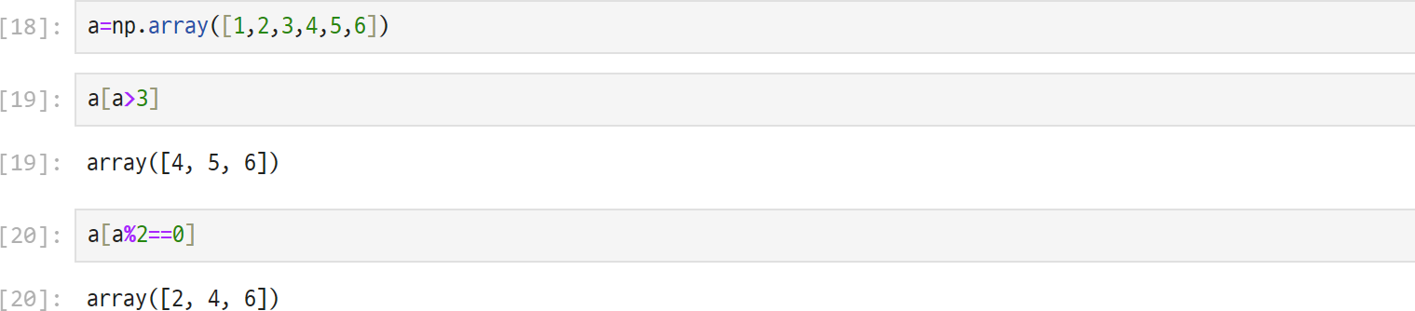
1.4. NumPy Indexing and Slicing
UNIT 01
Line 19
Only elements that meet the conditions of “a>3” are returned.
Line 20
Only even numbers are returned.

Slide 24
Code
import numpy as np
a = np.array([1, 2, 3, 4, 5, 6])
# Select elements greater than 3
a[a > 3]
# Select even numbers
a[a % 2 == 0]
Output
>>> a[a > 3]
array([4, 5, 6])
>>> a[a % 2 == 0]
array([2, 4, 6])
This technique is called Boolean (Conditional) Indexing, where NumPy selects only the elements that satisfy the given condition.

Slide 25

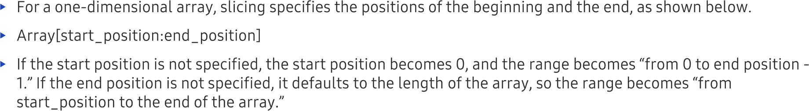
1.4. NumPy Indexing and Slicing
UNIT 01
Code
import numpy as np
# Create a 1D array
b1 = np.array([0, 10, 20, 30, 40, 50])
# Slice the array from index 1 to index 3
print(b1[1:4])
Output
[10 20 30]

Slide 26
Consider this 3 × 3 array
import numpy as np
arr = np.array([[1, 2, 3],
[4, 5, 6],
[7, 8, 9]])
print(arr)
Output
[[1 2 3]
[4 5 6]
[7 8 9]]
Row \ Column | 0 | 1 | 2
0 | 1 | 2 | 3
1 | 4 | 5 | 6
2 | 7 | 8 | 9

Slide 27
Row \ Column | 0 | 1 | 2
0 | 1 | 2 | 3
1 | 4 | 5 | 6
2 | 7 | 8 | 9
Every element has two addresses:
Row number
Column number
For example,
5 is at (1,1)
8 is at (2,1)
3 is at (0,2)
arr [1,2]
Go to Row 1 and Column 2.
Output
6
arr [2,0]
Go to Row 2 Column 0
Output
7

Slide 28
The colon simply means
start : end
where
start is included
end is excluded
Example
1:3
means
1,2
:2
means
0,1
because it starts from 0.
And
1:
means
1 till the end

Slide 29

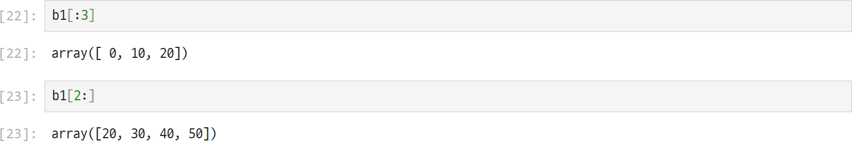
1.4. NumPy Indexing and Slicing
UNIT 01

Slide 30
Code
import numpy as np
# Create a 1D array
b1 = np.array([0, 10, 20, 30, 40, 50])
# Slice from the beginning to index 2
print(b1[:3])
# Slice from index 2 to the end
print(b1[2:])
Output
[ 0 10 20]
[20 30 40 50]

Slide 31
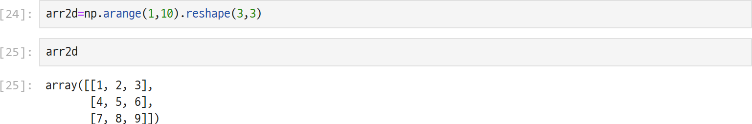
1.4. NumPy Indexing and Slicing
UNIT 01
Line 26
Choose from the beginning to the second line of “arr2d.”

Slide 32
Code
import numpy as np
# Create a 3 × 3 array
arr2d = np.arange(1, 10).reshape(3, 3)
print(arr2d)
# Slice the first two rows
print(arr2d[:2])
Output
[[1 2 3]
[4 5 6]
[7 8 9]]
[[1 2 3]
[4 5 6]]

Slide 33
1.4. NumPy Indexing and Slicing
UNIT 01

Slide 34
Code
import numpy as np
# Create a 3 × 3 array
arr2d = np.arange(1, 10).reshape(3, 3)
print(arr2d)
# Select the first two rows and last two columns
print(arr2d[:2, 1:])
# Select the first two columns of the second row
print(arr2d[1, :2])
Output
[[1 2 3]
[4 5 6]
[7 8 9]]
[[2 3]
[5 6]]
[4 5]

Slide 35
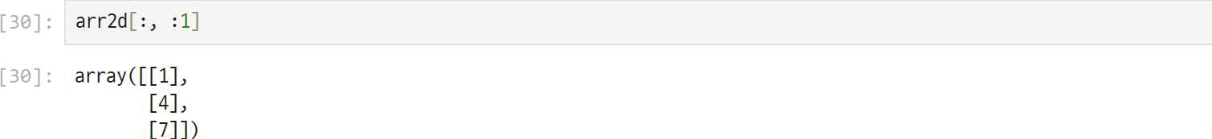
1.4. NumPy Indexing and Slicing
UNIT 01

Slide 36
import numpy as np
# Create a 3 × 3 array
arr2d = np.arange(1, 10).reshape(3, 3)
print(arr2d)
# Select the third column from the first two rows
print(arr2d[:2, 2])
# Select the first column from all rows
print(arr2d[:, :1])
Output
[[1 2 3]
[4 5 6]
[7 8 9]]
[3 6]
[[1]
[4]
[7]]

Slide 37













1.4. NumPy Indexing and Slicing
UNIT 01

Slide 38
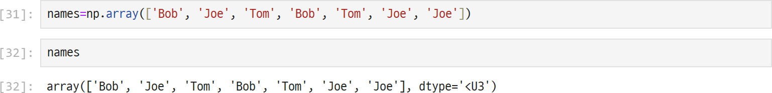
1.4. NumPy Indexing and Slicing
UNIT 01

Slide 39
import numpy as np
# Create an array of names
names = np.array(['Bob', 'Joe', 'Tom', 'Bob', 'Tom', 'Joe', 'Joe'])
# Display the array
print(names)
# Check which elements are equal to 'Bob'
print(names == 'Bob')
# Select only the elements that are 'Bob'
print(names[names == 'Bob'])
Output:
['Bob' 'Joe' 'Tom' 'Bob' 'Tom' 'Joe' 'Joe']
[ True False False True False False False]
['Bob' 'Bob']

Slide 40

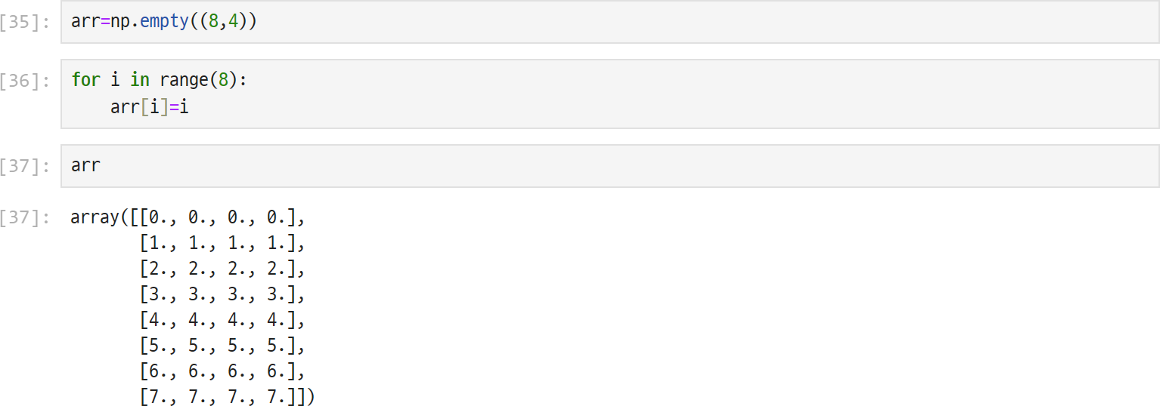
1.4. NumPy Indexing and Slicing
UNIT 01

Slide 41
import numpy as np
# Create an empty array with 8 rows and 4 columns
arr = np.empty((8, 4))
# Fill each row with its row index
for i in range(8):
arr[i] = i
# Display the array
print(arr)
Output
[[0. 0. 0. 0.]
[1. 1. 1. 1.]
[2. 2. 2. 2.]
[3. 3. 3. 3.]
[4. 4. 4. 4.]
[5. 5. 5. 5.]
[6. 6. 6. 6.]
[7. 7. 7. 7.]]

Slide 42

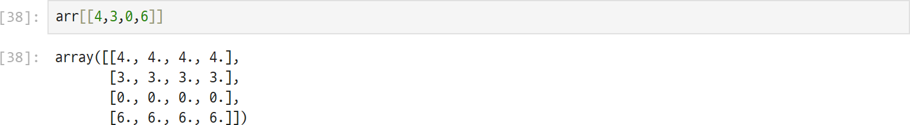
1.4. NumPy Indexing and Slicing
UNIT 01

Slide 43
import numpy as np
# Create an empty array with 8 rows and 4 columns
arr = np.empty((8, 4))
# Fill each row with its row index
for i in range(8):
arr[i] = i
print(arr)
# Fancy indexing - Select rows in a specific order
print(arr[[4, 3, 0, 6]])
# Fancy indexing using negative indices
print(arr[[-3, -5]])
Output:
[[0. 0. 0. 0.]
[1. 1. 1. 1.]
[2. 2. 2. 2.]
[3. 3. 3. 3.]
[4. 4. 4. 4.]
[5. 5. 5. 5.]
[6. 6. 6. 6.]
[7. 7. 7. 7.]]
[[4. 4. 4. 4.]
[3. 3. 3. 3.]
[0. 0. 0. 0.]
[6. 6. 6. 6.]]
[[5. 5. 5. 5.]
[3. 3. 3. 3.]]

Slide 44
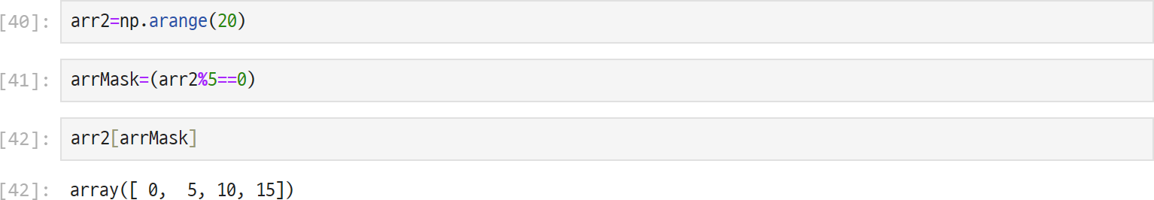
1.4. NumPy Indexing and Slicing
UNIT 01

Slide 45
import numpy as np
# Create an array with values from 0 to 19
arr2 = np.arange(20)
# Create a Boolean mask for multiples of 5
arrMask = (arr2 % 5 == 0)
# Select only the elements where the mask is True
print(arr2[arrMask])
Output
[ 0 5 10 15]

Slide 46
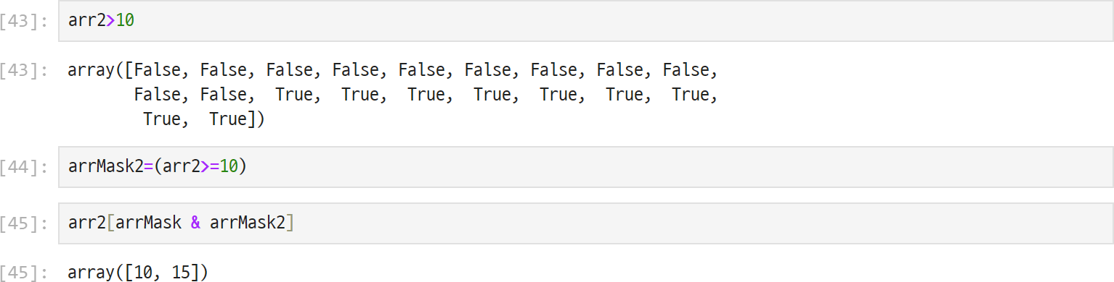
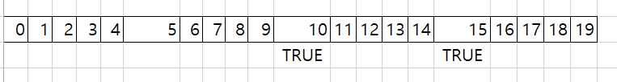
1.4. NumPy Indexing and Slicing
UNIT 01

Slide 47
import numpy as np
# Create an array from 0 to 19
arr2 = np.arange(20)
# Condition 1: Multiples of 5
arrMask = (arr2 % 5 == 0)
# Condition 2: Numbers greater than or equal to 10
arrMask2 = (arr2 >= 10)
# Combine both conditions
print(arr2[arrMask & arrMask2])
Output
[10 15]

Slide 48


1.4. NumPy Indexing and Slicing
UNIT 01

